Slide 1
BASICS OF OS AND KERNEL
Mohammed Aasif – ENG18CS1003
Yash Advani – ENG17CS0254
Sahana N – ENG16CS0134
V Maheshwari Sanjana – ENG17CS0236

Slide 2
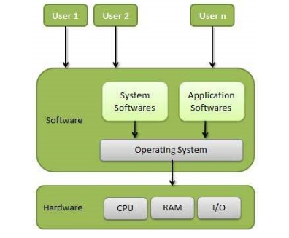
Basics Of Operating System
An Operating System (OS) is an interface between a computer user and computer hardware and controls the execution of all kinds of programs..
An operating system is a software which performs all the basic tasks like file management, memory management, process management, handling input and output, and controlling peripheral devices such as disk drives and printers.

Slide 3
The operating system acts as a bridge between the user applications/tasks and the underlying system resources through a set of system functionalities and services.
The OS manages the system resources and makes them available to the user applications/tasks on a need basis.
Some popular Operating Systems include Linux Operating System, Windows Operating System, VMS, OS/400, AIX, z/OS, etc.
The primary functions of an operating system are:
Make the system convenient to use
Organize and manage the system resources efficiently and correctly

Slide 4
Some of important functions of an operating System
Memory Management
Processor Management
Device Management
File Management
Security
Control over system performance
Job accounting
Error detecting aids
Coordination between other software and users

Slide 5
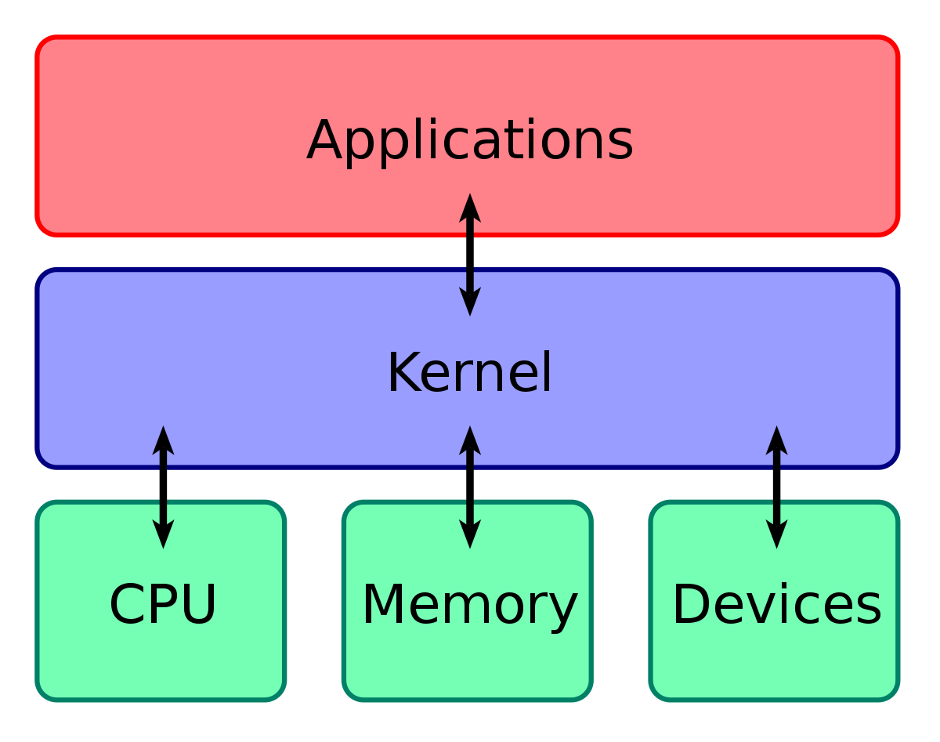
The Kernel
kernel forms the heart of an operating system.
The kernel is the core of the operating system and is responsible for managing the system resources and the communication among the hardware and other system services.

Slide 6
It is an integral part of any operating system.
It is one of the first programs loaded on startup after the bootloader . It handles the rest of startup as well as (I/O) requests from software, translating them into data-processing instructions for the cpu.
It handles memory and peripherals like keyboards, monitors, printers, and speakers.
Kernel acts as the low level abstraction layer between system resources and user applications.
Kernel contains a set of system libraries and services.
There are different kernel architecture designs which are classified into
Monolithic Kernel
Microkernel

Slide 7
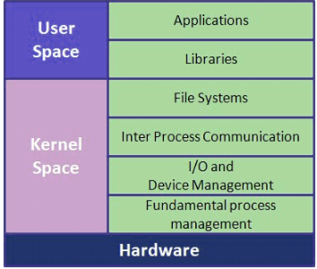
Monolithic Kernel
Monolithic Kernel run entirely in a single address space with the CPU executing in supervisor mode, mainly for speed.
The major drawback of monolithic kernel is that any error or failure in any one of the kernel module leads to crashing of the entire kernel applications.
LINUX,SOLARIS ,MS-DOS kernels are example of monolithic kernel

Slide 8
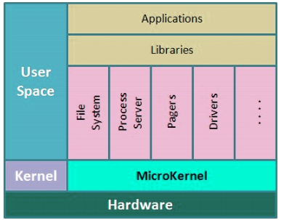
Microkernel
Microkernel run most but not all of their services in user space, like user processes do.
This design incorporates only essential set of operating system services into the kernel.
The rest of the services are implemented in servers which run in user space.
QNX,MINIX 3 kernels are example of microkernel.

Slide 9
Kernel space & user space
The applications/services are classified into two categories
User Applications
Kernel Applications
The critical code of the kernel is usually loaded into a separate area of memory, which is protected from access by application programs or other, less critical parts of the operating system. The kernel performs its tasks, such as running processes, managing hardware devices such as the hard disk, and handling interrupts, in this protected kernel space.

Slide 10
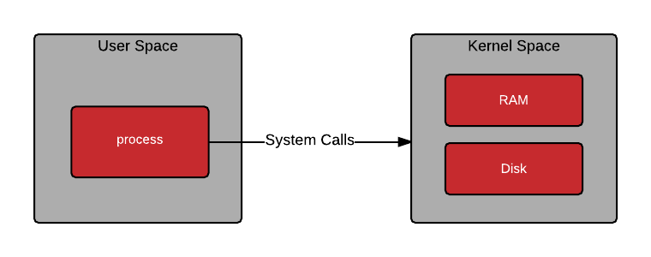
In contrast, application programs like browsers, word processors, or audio or video players use a separate area of memory, user space. This separation prevents user data and kernel data from interfering with each other and causing instability and slowness, as well as preventing malfunctioning application programs from crashing the entire operating system.

Slide 11
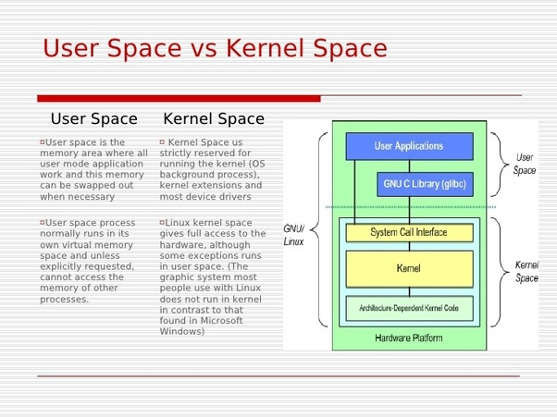

Slide 12
The partitioning of memory into kernel and user space is purely os dependent.
Some os implement this kind of partitioning whereas some do not segregate the kernel and user application code.
In operating system with virtual memory support, the user applications are loaded into its corresponding virtual memory space with demand paging technique.

Slide 13
Thank You

